Slide 1
Building the Ecosystem: Integrating CMS, CRM AND Marketing Automation
CRM Workshop – March 2018

Slide 2
1973
Adventist Health System was established
45
Hospitals in key markets
80,000
Employees and physicians
10,500
Staff physicians
5 million+
Patients served annually
15
Skilled nursing facilities
22
Home health and hospice agencies

Slide 3
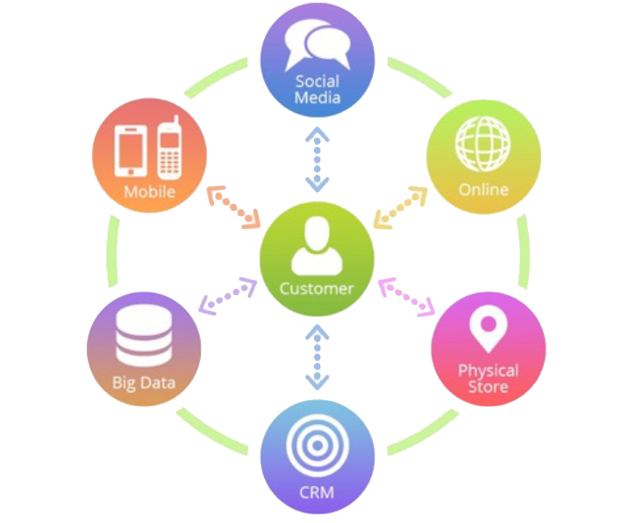
Trends in Healthcare Marketing
Shifting to be customer-centric
Healthcare marketing has to be accountable
Shift to integrated digital, social, mobile multi-channel marketing strategy
Technology needs to support organization’s ability to present fresh, social-sharing, smart content
Precision marketing – using data analytics to engage both current and future patients
Support growing need for location-based marketing efforts
3

Slide 4
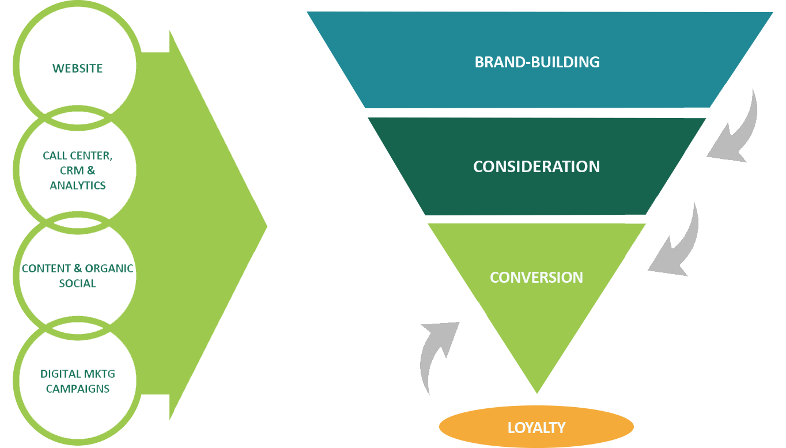
We Must Address The Full Consumer Decision Cycle
4
Notes:
Of course we want our customers, ultimately, to make an appointment with us. That’s what WE want. Our customers? They may not always be at the point in THEIR journey where they are ready to make that appointment. They may want information or advice. They may want reassurance. They may want driving directions. If we help them, however they want or need that help, then when the time comes to make an appointment, we will be their natural choice.

Slide 5
Consumers want their Digital Healthcare Experience to be More Like Retail
78% of the more tech-savvy consumers say the healthcare digital customer experience needs improvement, and 50% said they would leave their current physician for a better digital customer experience.
More than half (69%) of respondents expect their health insurer to make it easier to navigate affordable care and wellness options.
Consumers want fast and easy digital experiences, but mobile healthcare is perceived as lacking ease of use and features, with 62% of respondents citing it is not able to accomplish what they want it to do, 42% of respondents citing a lack of relevant options and 40% of respondents citing mobile healthcare takes too long to complete.
Here are the six areas consumers respondents said improvement is most needed in.
Searching for a physician or specialist (81 percent)
Accessing a family member's health records (80 percent)
Changing or making an appointment (79 percent)
Accessing test results (76 percent)
Paying bills (75 percent)
Filling a prescription (74 percent)
NTT DATA Survey - 1,102 U.S. healthcare consumers during September 2017
5
Notes:
Consumers want their digital healthcare experience to be more like retail: 4 things to know
Written by Julie Spitzer | March 08, 2018 | Print | Email
inShare
Healthcare consumers want their digital experiences for routine healthcare transactions — like paying medical bills or filling prescriptions — to be similar to retail, according to results of a survey commissioned by NTT DATA Services.
The research was based on online responses from nearly 1,102 U.S. healthcare consumers during September 2017. NTT DATA specifically sought to answer three questions:
· How satisfied are consumers with the digital customer experience across healthcare companies?
· Where could physicians' offices or healthcare insurers provide more seamless care?
· How do consumers prefer to interact with healthcare organizations?
Here are four things to know.
1. Seventy-eight percent of the more tech-savvy consumers say the healthcare digital customer experience needs improvement, and 50 percent said they would leave their current physician for a better digital customer experience.
2. More than half (69 percent) of respondents expect their health insurer to make it easier to navigate affordable care and wellness options.
3. Consumers want fast and easy digital experiences, but mobile healthcare is perceived as lacking ease of use and features, with 62 percent of respondents citing it is not able to accomplish what they want it to do, 42 percent of respondents citing a lack of relevant options and 40 percent of respondents citing mobile healthcare takes too long to complete.
4. Here are the six areas consumers respondents said improvement is most needed in.
· Searching for a physician or specialist (81 percent)
· Accessing a family member's health records (80 percent)
· Changing or making an appointment (79 percent)
· Accessing test results (76 percent)
· Paying bills (75 percent)
· Filling a prescription (74 percent)
"While digital experience may have a moderate impact on overall healthcare decisions made today, it is changing at an increasing rate," said Alan Hughes, COO of NTT DATA. "Providers, insurers and pharmacies taking heed of the trend will be best suited to fulfill patient expectations."

Slide 6
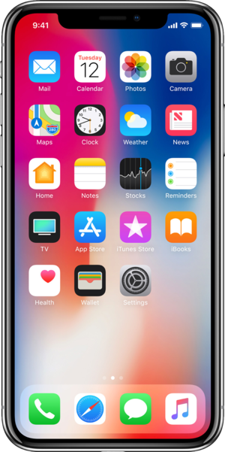
Overall Digital Strategy – Think Mobile
Google is getting much closer to launching the Mobile-First Index
79% of people surveyed use their smartphone for reading email -- a higher percentage than those who used it for making calls. (Email Monday)
By 2019, mobile advertising is expected to represent 72% of all U.S. digital ad spending. (MarketingLand)
57% of users say they won’t recommend a business with a poorly-designed mobile site. (socPub)
48% of consumers start mobile research with a search engine --but 33% go directly to the site they want. (Smart Insights)
6
Notes:
Google drives 96% of mobile search traffic, followed by Yahoo at 2% and Bing at 1%. (NetMarketShare)
One of the most misunderstood points about the Mobile-First Index is that Google intends it to be the primary index – for both mobile and desktop searches. It is called ‘mobile-first’ because the crawler is evaluating the content as a mobile phone rather than a desktop computer, so content that would not be linked or visible for a mobile phone might not get included in this index. The idea is that Google wants us to consider the content in a ‘mobile-first’ setting, but not necessarily a ‘mobile-only’ setting.
In terms of algorithms and ranking, Google has confirmed, at least in a pagespeed context that results will be device specific – faster pages will rank better on mobile, but the speed guidelines will be less strict on desktop – as illustrated in the Twitter conversation with John Mueller from Google shown to the right. This lends itself well to the theories presented in the previous article in the series, which suggested that while the index may stay the same across the many different devices and search options, the algorithms will likely adapt to the device, context and personalized needs of the searcher.

Slide 7
2017 Current State of Healthcare Marketing Technologies
Nearly six in ten (57%) healthcare organizations have a customer relationship management (CRM) system, but only 29% said their CRM and CMS systems are integrated, with only 12% well integrated.
Healthcare organizations employing marketing automation use it primarily for streamlining the email process and creating relationships through engagement marketing and nurturing prospective customers.
63% of healthcare systems do not user / or unsure if they utilize a marketing automation tool. 2/3 of all those who do not have a marketing automation tool still have no plans to implement one in the next year.
Analytics still predominantly measured by Google Analytics, but organizations are beginning to leverage patient ROI to validate efforts through CRM.
Study performed by Greystone.Net and Klein & Partners
7

Slide 8
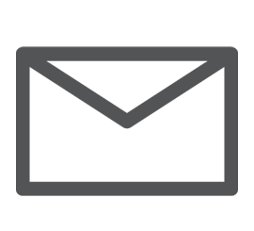
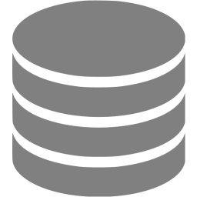
What Should your Ecosystem Really Look Like?
Websites
CMS
CRM
Marketing
Automation
EMR
Analytics

Slide 9
What it Probably Looks Like…
Websites
3rd Party Email Tool
CRM 2
CMS
Marketing
Automation
CMS 2
CRM
EMR
Analytics
Rogue 3rd Party Email Tool
Analytics
Analytics
Analytics
Analytics

Slide 10
Website and CRM Integration
How well are healthcare system integrating their website and CRM?
(3rd Annual State of Healthcare Digital Marketing Report – October 2017)
10

Slide 11
What does CMS/CRM Integration Really Mean?
Connecting your Website with your CRM
No one way to connect, multiple options to perform
Need to define early business objectives along side technical resources/budgets
Start with basics: CRM web forms integrated within your website
Integrate content: Display CRM data within website pages / host CRM content within web page
Collect web sessions: Connect sessions of web users with CRM users, passing web history / visitation in CRM
11

Slide 12
What is Marketing Automation?
Marketing automation is a tactic that allows companies to nurture prospects using highly personalized, valuable content that helps convert these prospects into leads, and turn those leads into customers.
Many marketing departments have to automate repetitive tasks such as emails, social media, and other website actions. The technology of marketing automation makes these tasks easier.

Slide 13
Adoption of Marketing Automation by Industry
Industry Segment Descriptors
Maintainers
Transformers
Skeptics
Laggards
Fine-tuning their earlier marketing automation investments.
Investing in business change, of which marketing automation is potentially a key component.
Evaluating how marketing automation can best be applied to their industries.
Most are yet to actively consider wholesale adoption of marketing automation.
Industry Adoption of Marketing Automation
Technology
Financial Markets
Life Sciences
Oil & Gas
Manufacturing
Professional Services
Retail Banking
Media
Retail
Insurance
Health Insurance
Telecoms
Education
Higher Education
Government
Healthcare
Utilities
– Ovum “Industry Adoption of Marketing Automation
Notes:
Started around early 2000s
Across 17 industry sectors there are four main industry groupings of marketing automation adopters: "maintainers," "transformers," "skeptics," and "laggards." The report identifies the industries that should evaluate marketing automation urgently to avoid being left at a strategic competitive disadvantage.
SHSMD Survey of 40 healthcare marketers prior to a recent Marketing Automation presentation showed that 75% did not have a marketing automation tool or were unaware if they had one
Marketing Automation Trends Survey, Three Deep and Ascend2, April 2016
Expectations for marketing automation systems are very high with an overwhelming 94% of the best-in-class saying it is “Very important” to the overall performance of marketing.

Slide 14
CRM vs. Marketing Automation vs. Email Tool
CRM | Marketing Automation | Email Tool
Stores information such as a consumer/patient addresses, names, phone numbers, and interactions with the health system | Streamlines, automates, and measure marketing tasks and workflows | Only tracks interactions related to email campaigns (whereas marketing automation tracks the entire chain of interactions)
Helps to acquire and keep patients by making all of the interactions with your health system personalized and seamless | Tracks and automates interactions with patients/consumers across channels including email and website | Limited capabilities for automating campaigns over time or based on behavior or criteria
Health systems/hospitals today require a CRM to store the information and data, and a marketing automation tool to act upon that data

Slide 15
Benefits of Marketing Automation
– Redeye and TFM&A Insights “The Marketing Automation Report”
Notes:
Of the 250 marketers who responded to the survey, they are almost perfectly split between non-adopters of MA (124) and adopters of MA (126). When we examine how people feel about the benefits of MA

Slide 16
Marketing Automation takes time to see results
“Only 8% of companies see increased revenues within 6 months of adopting marketing automation.
After one year of MA use 32% claim to see increased revenue. For those to have been using it for more than two years the figure is 40%.”
– B2Bmarketing.net and Circle Research “Benchmarking Report Marketing automation” (2015)

Slide 17
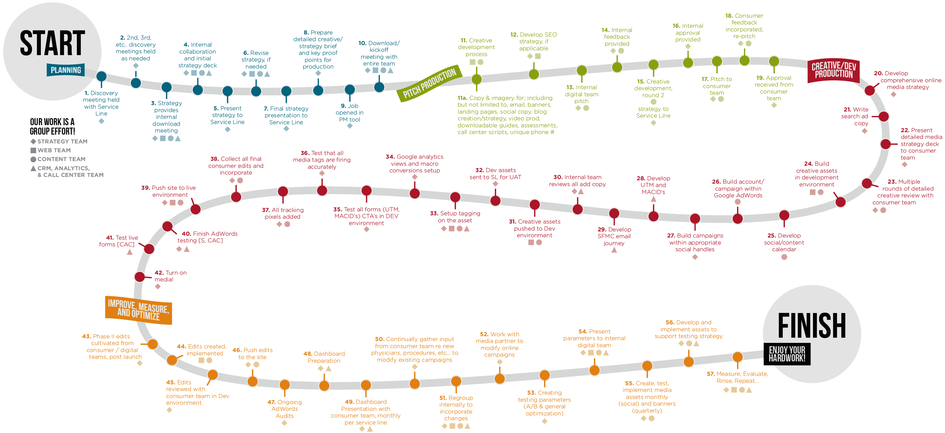
Our Digital Marketing Campaign Journey

Slide 18
Signs when to invest in CMS / CRM integration?
Buy in from senior leadership, aligned with strategic goals and objectives
Developed strong web foundation, and infrastructure is solid
Ready to implement content strategy and content development
Available qualified resources and budgets

Slide 19
Signs when to invest in Marketing Automation?
Generating a steady flow of new and qualified prospects
High number of potential prospects/patients and unable to nurture optimally through manual efforts
Proven lead nurturing strategy that you want to scale
Strong content strategy mapped to your patient’s journey
Are you tracking your prospects/patients actions across multiple touch point and marketing channels (not just email)

Slide 20
Questions?

